Slide 1

Time Series Decomposition
Facultad de Ciencias Económicas
Catedrático: Franz Haidacher

Slide 2
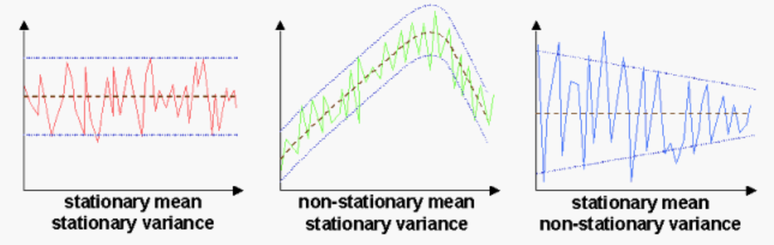
Stationarity

Slide 3
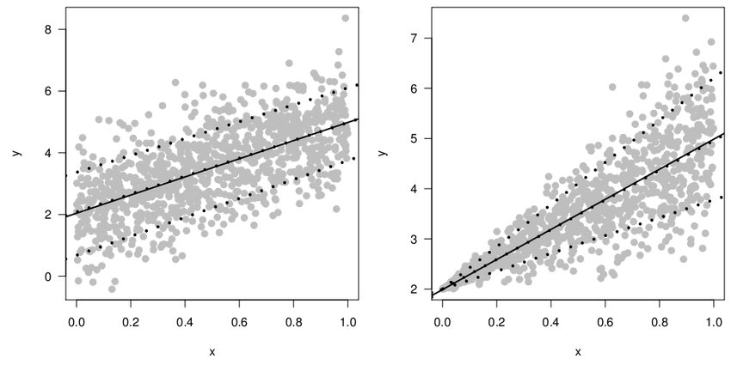
Homoscedasticity vs Heteroscedasticity

Slide 4
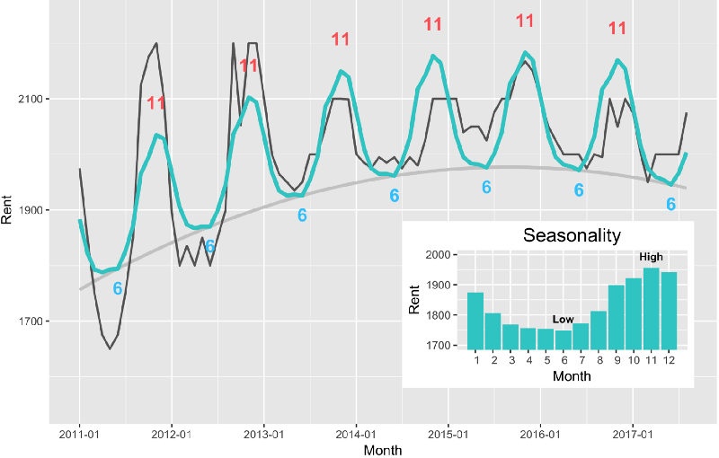
Seasonality

Slide 5
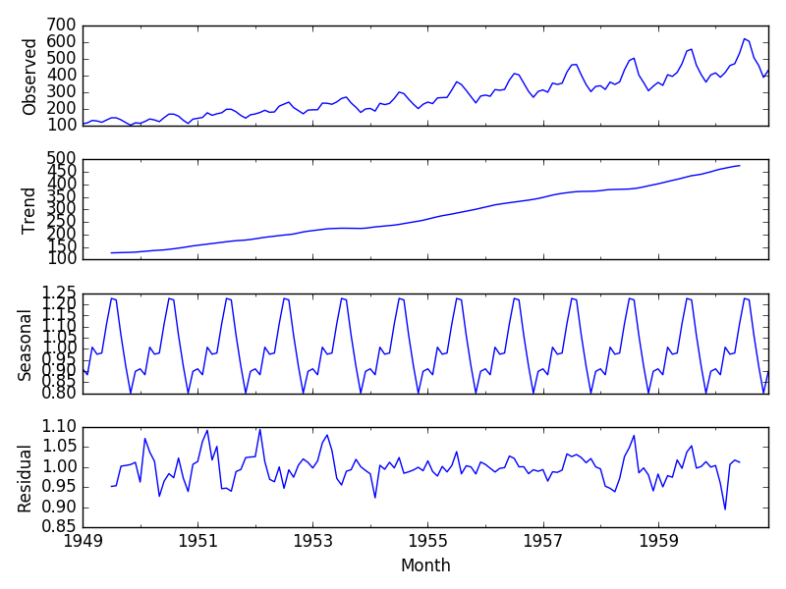
Time Series Decomposition

